Slide 1

OI Hackathon 2022 Project Name : Plastic Picker using Robotic ARM TeamName : Digital_Banking
JURY PRESENTATIONS
Dec, 2022

Slide 2
TEAM INFO
Team Name: Digital_Banking
Team Member's:
Rajeev Swarnakar
Sanket Patil
Prathamesh Thorat
Rushikesh Kasle
Shubhanshu Sahu
GUIDED BY:
Manivanan Murugavel
We are technology enthusiast team of full stack engineers working in various domains.

Slide 3
PROJECT INFO
Project Name : Plastic Picker using Robotic ARM
Short Description of the Project :
Our project is about developing a platform to seperate plastic from garbage using robotic arm.
What is the problem you’re solving? :
We will automate the entire plastic segregation process because currently garbage is sorted manually by humans, which is a slow procedure.
How are you solving it?
We are using deep learning, computer vision technique and applying neural network to select the plastic from the garbage.
Collected the data set from available source.
We have applied the transfer learning technique to develop neural network model to detect and segregate the garbage.

Slide 4
TECHNICAL DETAILS
Tech stack info
Programming Language used: Python
Code Editor: VS code
Opensource software : TensorFlow, U-Net (Neural network architecture), kaggle.com

Slide 5
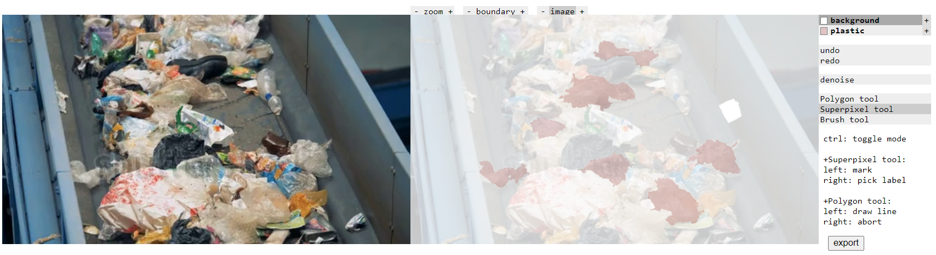
PROJECT DEMO
Demo Video Link : demo.mp4

Slide 6
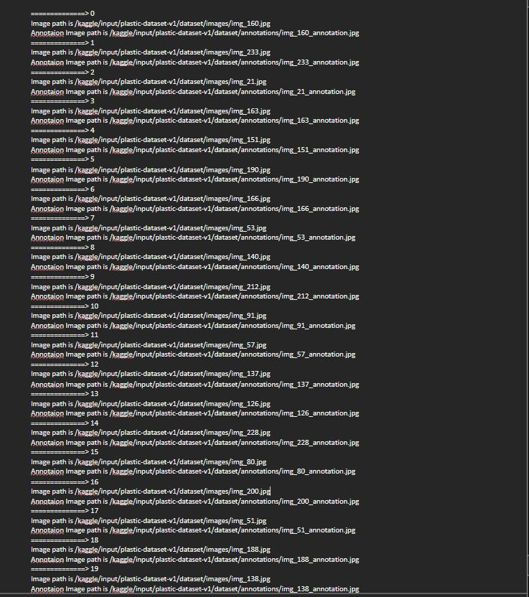

Slide 7
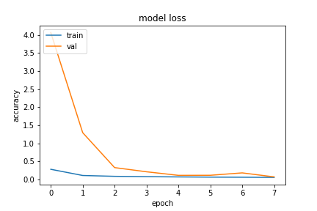
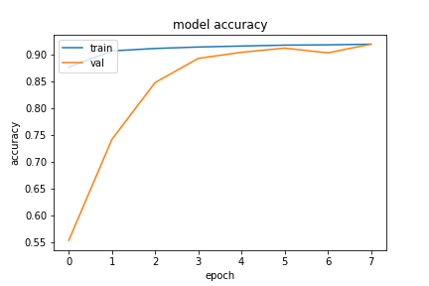
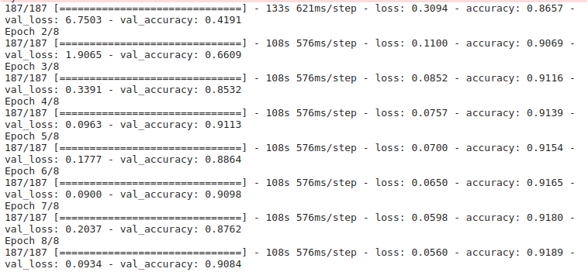

Slide 8
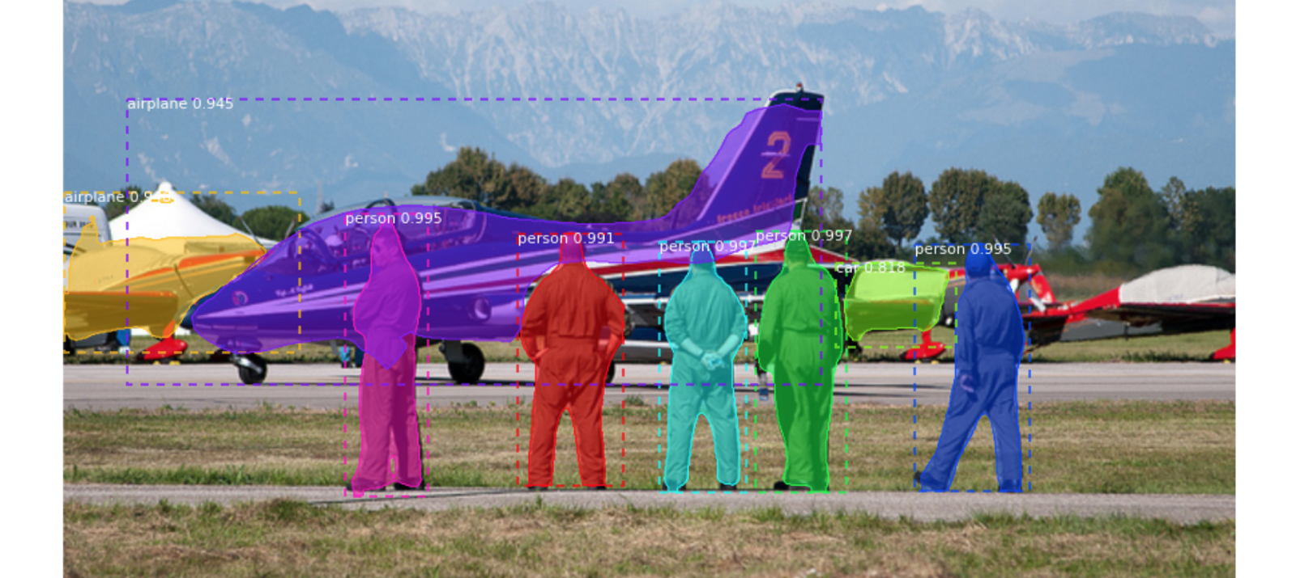
Mask R-CNN

Slide 9
THANK YOU

